Slide 1

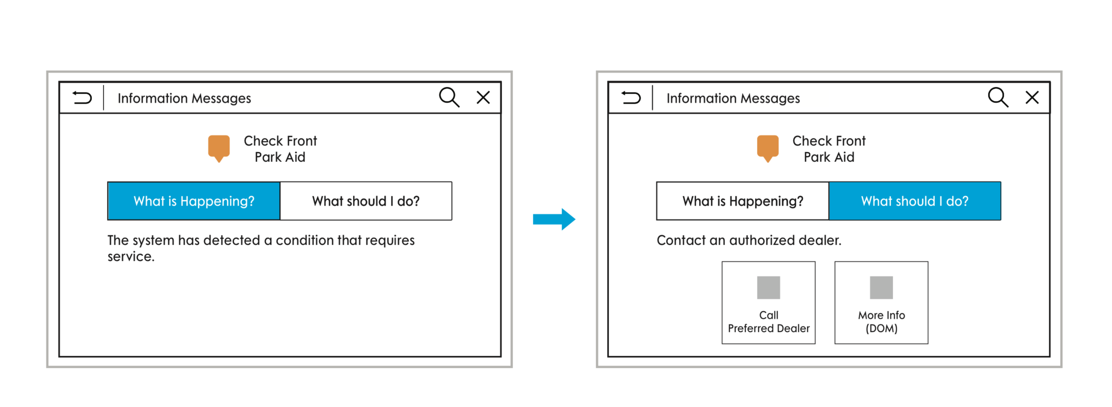
Considerate Prompts 2.0
Customer Need
Today, warnings appear with very limited information on the severity of the issue, the problem that triggered the warning, and what steps should be taken to resolve. When a warning is triggered, customers need to be easily linked to further education on the problem, as well as the possible solutions, explained in a very human way, in order to resolve. Customers need to feel both empowered and taken care of when vehicle problems arise.
Pain Points: Many customers are unaware that the solutions to a number of warnings are already contained within the Owner’s Manual. For the warnings that do give the instruction to “See Manual”, there is no further direction for how/where to find the solution within the manual.
Passion Points: By providing a direct link, customers can be taken to the exact chapter/paragraph that contains the specific solution to the present warning. Surprise & delight when offering to assist with vehicle problems in a helpful and considerate way.
Benefits: Bringing forward the Digital Owner’s Manual, and identifying it to customers as a valuable, educational resource. Additionally, “Considerate Prompts 2.0” utilizes, and links together, existing enablers: Warnings + Digital Owner’s Manual.
Who is the customer?: Ford & Lincoln Customers
Potential Target Markets / Vehicles: Vehicles with Digital Owner’s Manual
Business Opportunity: Potential to drive eco-system revenue by recommending Ford/Lincoln Dealerships for the problems requiring vehicle service to resolve. Customer satisfaction improvement: TBD.
Linked Needs / Features: “Considerate Prompts”, Digital Owner’s Manual
Story/ Sketch / Picture
Considerate Prompt (Linking to Digital Owner’s Manual)
DOM solutions presented humanly
Customer Need Champion: Geoff Turbiak, Jayne Spence
Solution Champion: TBD – (CDSID, Phone #) (Innovation Roundtable Member added after submission to Roundtable)
Workstream Source: UX Infotainment & Connectivity
Additional Customer Insight materials Available:

